Slide 1
Age comp inv
Fishery data:
Currently computed for males/females, then combined (and, excludes unsexed data)
But, length comps have never been computed this way, have always combined sex data prior to expansion
Computed with FSA package, rather than the observed ALK
Idea: randomly assigns lengths to ages with an ALK approach
But, can obtain ages that weren’t observed, particularly because
Requires: must define smallest lengths in each year as age-1
Propose:
Combine age/length data across sexes pre-expansion
Use year-specific ALK & remove age-1 assignment (stop using FSA package)
Use proposed length comp expansion
Why? You’ll see…

Slide 2
Age comp inv
Fishery data:
Currently computed for males/females, then combined (and, excludes unsexed data)
But, length comps have never been computed this way, have always combined sex data prior to expansion
Computed with FSA package, rather than the observed ALK
Idea: randomly assigns lengths to ages with an ALK approach
But, can obtain ages that weren’t observed, particularly because
Requires: must define smallest lengths in each year as age-1
Propose:
Combine age/length data across sexes pre-expansion
Use year-specific ALK & remove age-1 assignment (stop using FSA package)
Use proposed length comp expansion
Why? You’ll see…

Slide 3
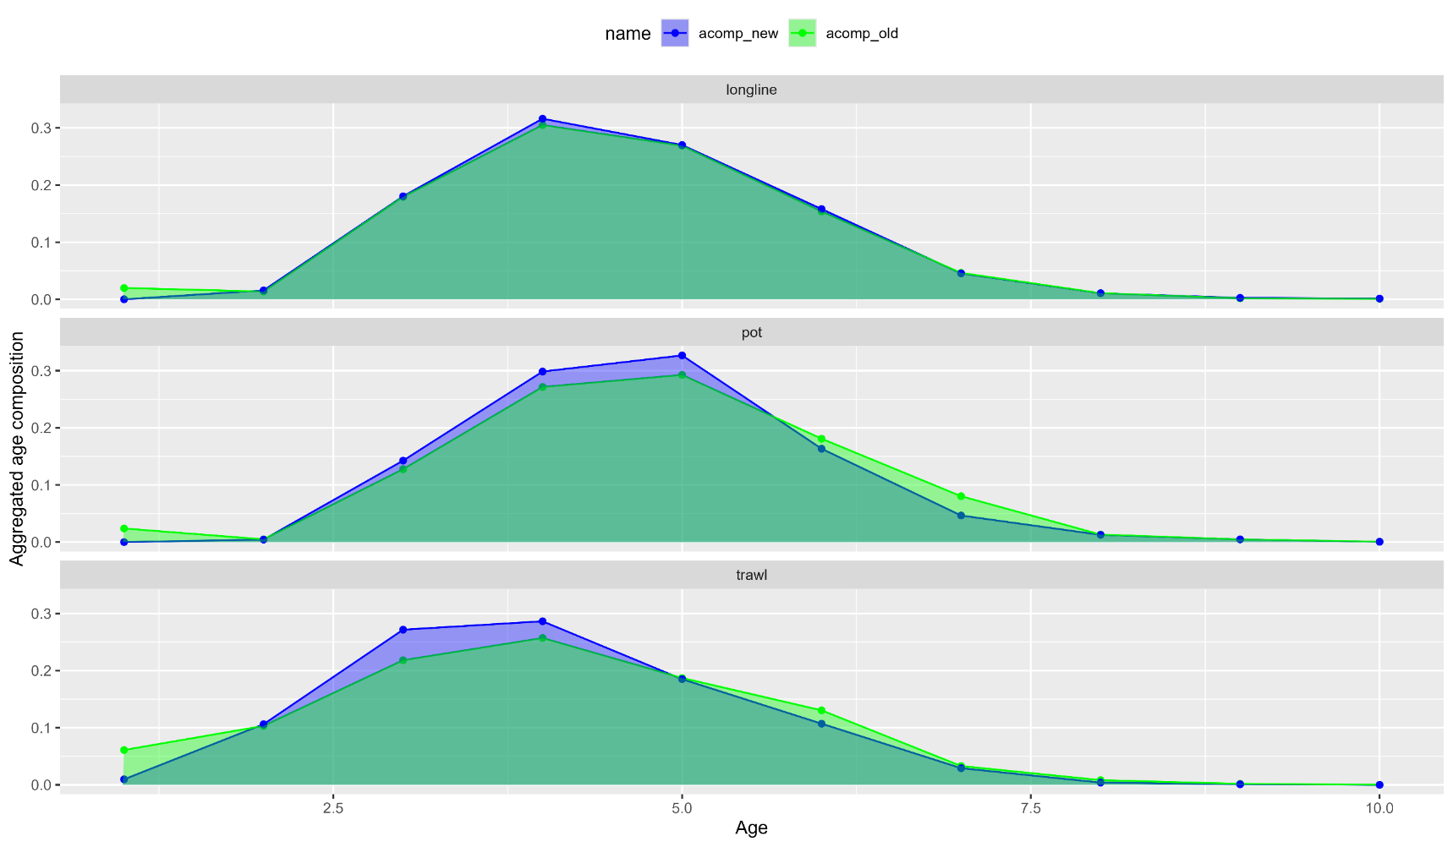
Age comp inv
Fishery data: aggregated plots

Slide 4
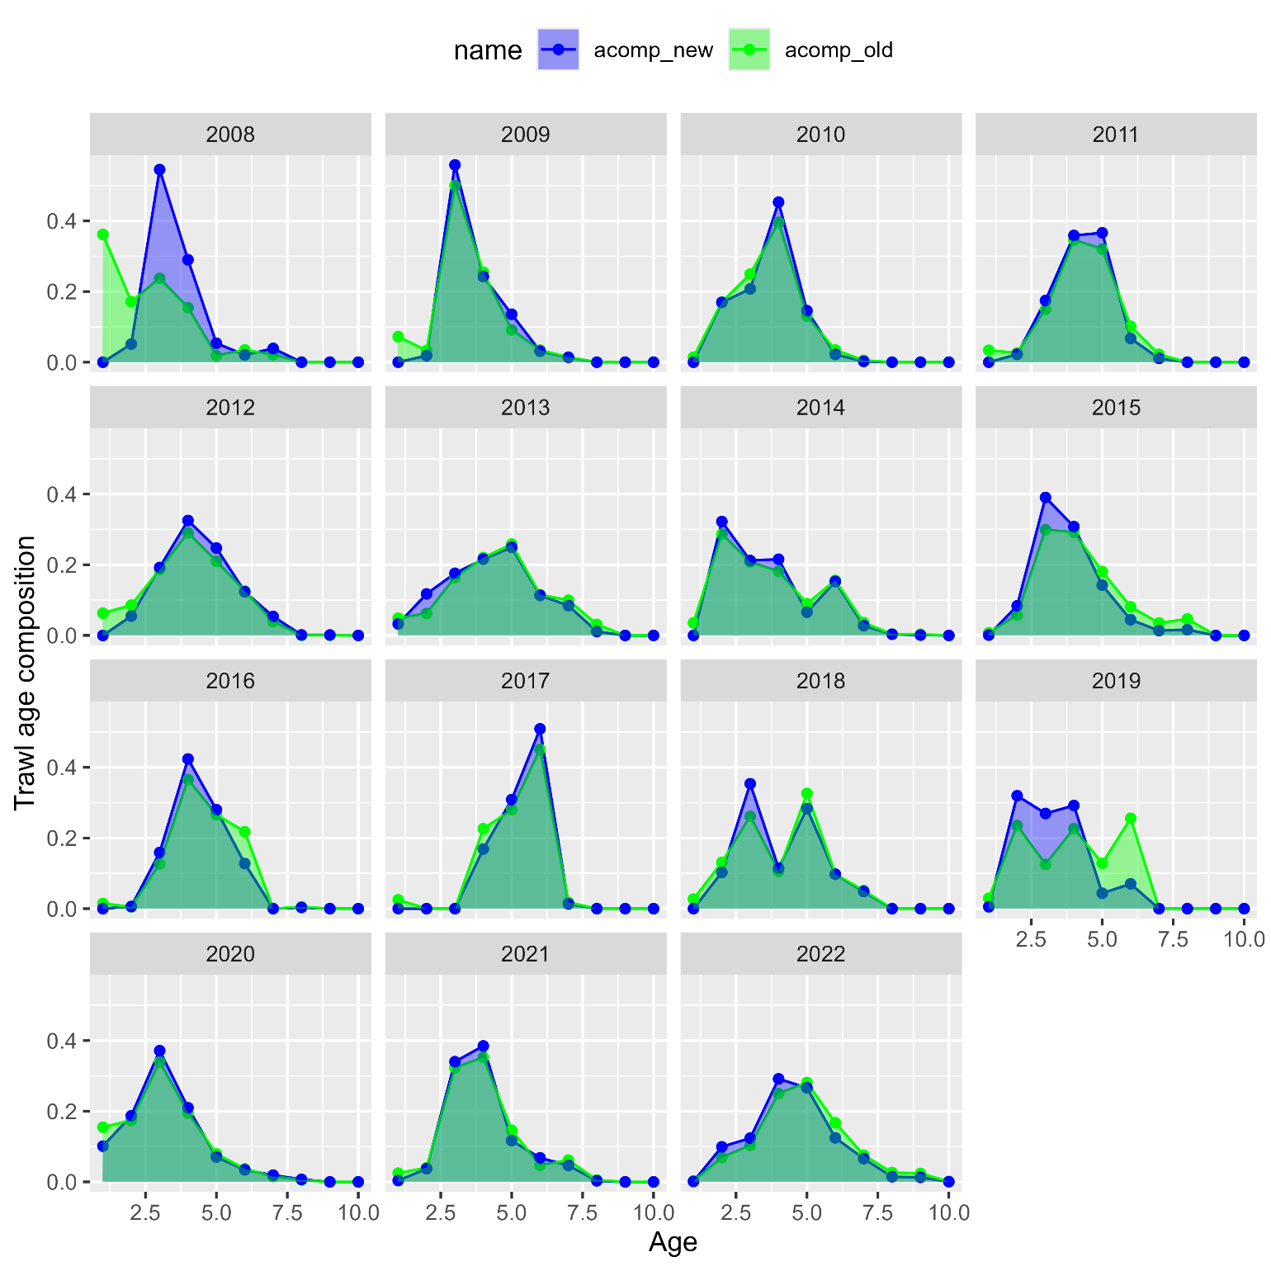
Age comp inv
Trawl fishery:

Slide 5
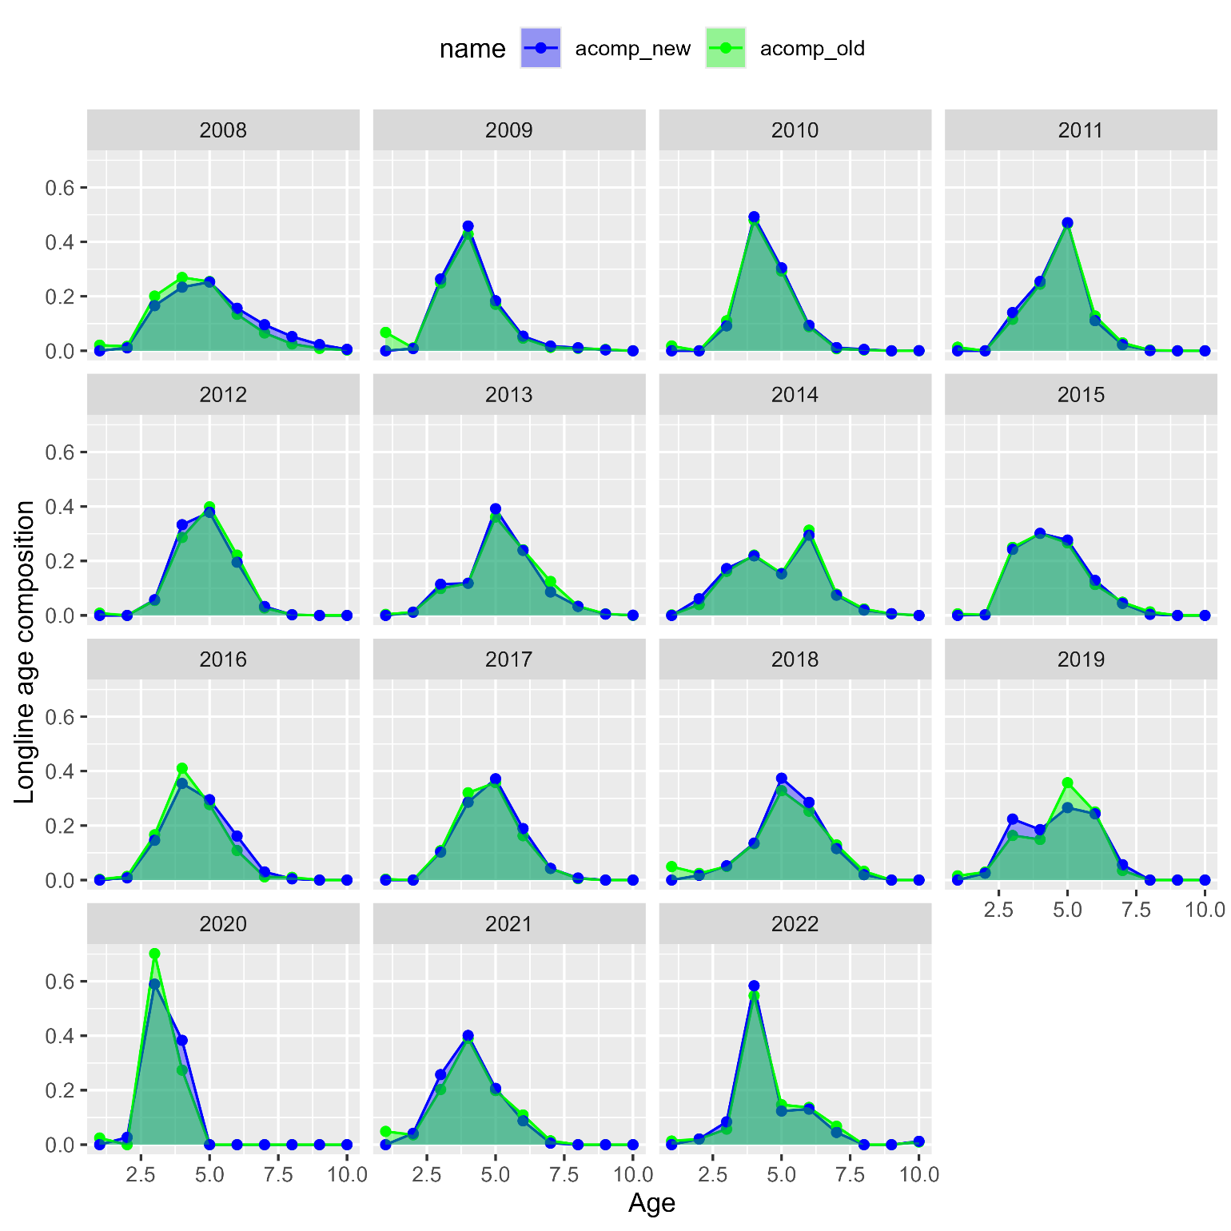
Age comp inv
Longline fishery:

Slide 6
Age comp inv
Pot fishery:

Slide 7
Age comp inv
Fishery data: aggregated plots

Slide 8
Age comp inv
Trawl fishery:

Slide 9
Age comp inv
Longline fishery:

Slide 10
Age comp inv
Pot fishery:

